Slide 1
Research Data Curation
Data documentation, organization, storage and sharing
Define a question
Gather information
Test the hypothesis
Analyze the data
Interpret the data
Publish results
Form a hypothesis
Retest
Aaron Collie
Digital Curation Librarian
collie@msu.edu

Slide 2
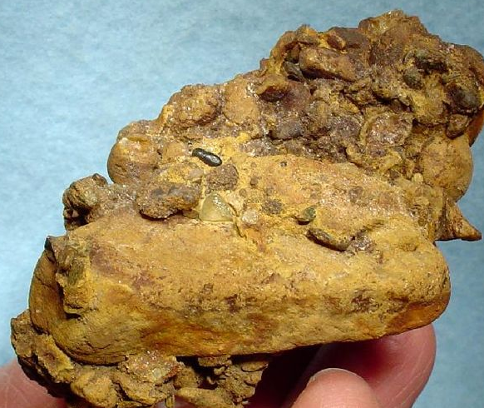

Data Management. Isn’t that… trivial?
Not so much. Data is a primary output of research; it is very expensive to produce high quality data. Data may be collected in nanoseconds, but it takes the expert application of research protocol and design to generate quality data.
CC-BY-SA-3.0 Rob Lavinsky
CC-BY-SA-3.0 Rob

Slide 3
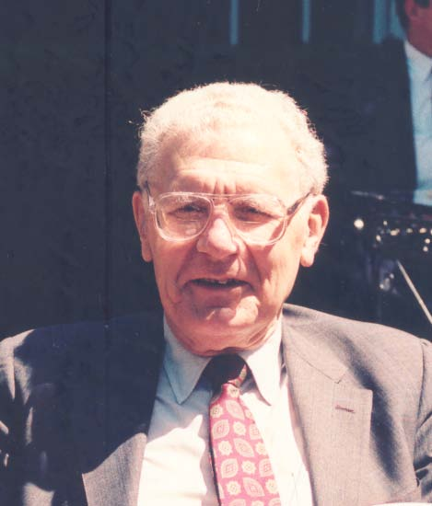
To put that into perspective, consider data as the product of an industry. Data is the output of a process that generates higher orders of understanding.
Wisdom
Knowledge
Information
Data
Understanding is hierarchical!
Russell Ackoff

Slide 4
Data Industries
In the academic sector that industry is called scholarly communication.
In the private sector that industry is called research & development.
Data
Research Article
Data
New Product

Slide 5
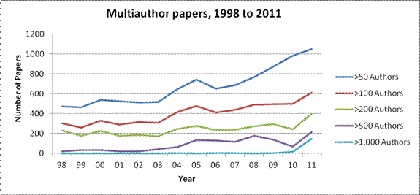
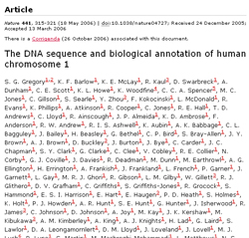
Industry is changing
Multiauthor Papers: Onward and Upward - ScienceWatch Newsletter. (n.d.). Retrieved October 4, 2013, from http://archive.sciencewatch.com/newsletter/2012/201207/multiauthor_papers/
The demise of the lone author : Article : History of the Journal Nature. (n.d.). Retrieved October 4, 2013, from http://www.nature.com/nature/history/full/nature06243.html

Slide 6

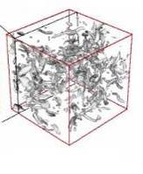


Science is always changing
Thousand years ago: science was empirical
describing natural phenomena
Last few hundred years: theoretical branch
using models, generalizations
Last few decades: a computational branch
simulating complex phenomena
Today: data exploration (eScience)
unify theory, experiment, and simulation
Data captured by instruments or generated by simulator
Processed by software
Information/Knowledge stored in computer
Scientist analyzes database / files using data management and statistics
Slide credit: Gray, J. & Szalay, A. (11 January 2007). eScience Talk at NRC-CSTB meeting. http://research.microsoft.com/en-us/um/people/gray/talks/NRC-CSTB_eScience.ppt

Slide 7
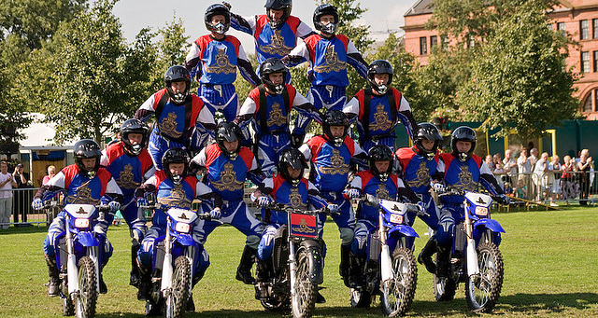
Research is now a team sport
(cc) SpoiltCat

Slide 8






This has been noticed.
“…must include a supplementary document of no more than two pages labeled ‘Data Management Plan’.”
“…expects the timely release and sharing of final research data"
“…should describe how the project team will manage and disseminate data generated by the project”
“…requires that data…be submitted to and archived by designated national data centers.”
NASA “promotes the full and open sharing of all data”
"IMLS encourages sharing of research data."
Notes:
National Oceanic and Atmospheric Administration (NOAA)
IMLS encourages sharing of research data. Applications that develop digital products must fill out an additional form with ten questions focused on “Developing Data Management Plans for Research Projects.
The federal government has the right to obtain, reproduce, publish or otherwise use the data first produced under an award and authorize others to do so for government purposes.”
Ex: Digging Into Data

Slide 9
But why are we really here?
Impetus: NSF has mandated that all grant applications submitted after January 18th, 2011 must include a supplemental “Data Management Plan”
Effect: The original NSF mandate has had a domino effect, and many funders now require or state guidelines for data management of grant funded research
Response: Data management has not traditionally received a full treatment in (many) graduate and doctoral curricula; intervention is necessary
Notes:
HANDOUT: DMP (blue)

Slide 10
Positive reinforcement….
National Science Foundation Data Management Plan mandate (January 18, 2011)
Presidential Memorandum on Managing Government Records (August 24, 2012)
Managing Government Records Directive: All permanent electronic records in Federal agencies will be managed electronically to the fullest extent possible for eventual transfer and accessioning by NARA in an electronic format.

Slide 11
Positive reinforcement… (cont.)
White House policy memo (February 22, 2013)
Increasing Access to the Results of Federally Funded Scientific Research: Federal agencies with more than $100M in R&D expenditures must develop plans to make the published results of federally funded research freely available to the public within one year of publication.
OSTP policy memo (March 20, 2014)
Improving the Management of and Access to Scientific Collections: directs each Federal agency that owns, maintains, or otherwise financially supports permanent scientific collections to develop a draft scientific-collections management and access policy within six months.

Slide 12
Curation responsibilities (Carlson, The Chronicle, 2006)
“Data from Big Science is … easier to handle, understand and archive.
Small Science is horribly heterogeneous and far more vast. In time Small Science will generate 2-3 times more data than Big Science.”
big science data
domain?
institution?
small science data
MacColl, John (2010). The Role of libraries in data curation. RLG Partnership Annual Meeting, Chicago. June 2010

Slide 13
This is the engine of the academic industry…
Define a question
Gather information
Test the hypothesis
Analyze the data
Interpret the data
Publish results
Form a hypothesis
Retest
Notes:
Research is a process, it is scientific, and we use an overarching model to describe the process at a high level. But this is a conceptual model, it is not a process model. But this is a pretty sterile model; and we know that because it is not prescriptive to all academic disciplines.

Slide 14
Define a question
Gather information
Test the hypothesis
Analyze the data
Interpret the data
Publish results
Form a hypothesis
Retest
Notes:
In practice, research is a complicated process. It is a creative process as well as a scientific process.

Slide 15
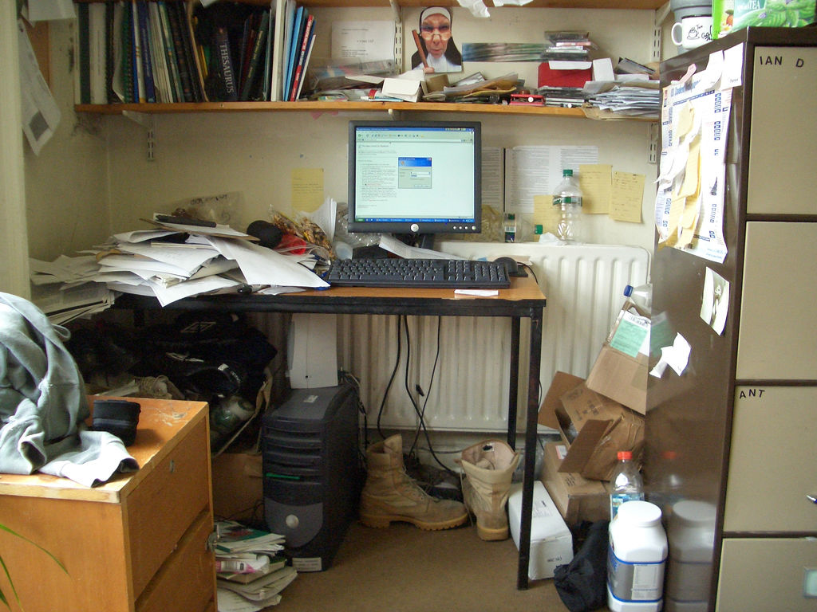
So, things can get a little messy.
Notes:
Research is hard, managing research is boring. So we want tips that make it easier.

Slide 16
Define a question
Gather information
Test the hypothesis
Analyze the data
Interpret the data
Publish results
Form a hypothesis
Retest
The scientific method “is often misrepresented as a fixed sequence of steps,” rather than being seen for what it truly is, “a highly variable and creative process” (AAAS 2000:18).
Gauch, Hugh G. Scientific Method in Practice. New York: Cambridge University Press, 2010. Print. (Emphasis added)
Notes:
This has been noticed.

Slide 17
Define a question
Gather information
Test the hypothesis
Analyze the data
Interpret the data
Publish results
Form a hypothesis
Retest
Notes:
You might think of the scientific method as a bit of an iceberg model. At the tip of the iceberg are these general activities, but research isn’t really conducted at this high of a level.

Slide 18
The Research Depth Chart
More Specific More Generic
Scientific Method
Research Method
Research Design
Research Tasks
Notes:
Research is a thing that happens at many levels simultaneously. The more experience you gain with research, the more of the depth chart you develop expertise within.

Slide 19
Define a question
Gather information
Test the hypothesis
Analyze the data
Interpret the data
Publish results
Form a hypothesis
Retest
Study Concept
Literature Review
Environmental Scan
Problem Identification
Funding & Proposal
Research Methodology
Research Workflow
Design Validation
Research Design
Hypothesis Formation
Research Activity
Data Organization
Data Storage
Data Description
Data Management
Data Sharing
Report Findings
Publish
Peer Review
Scholarly Communication
Notes:
Data management is a subprocess of research. It is part of a holistic research method that includes a ton of other functions like funding, literature reviews, workflows and publication.

Slide 20

Define a question
Gather information
Test the hypothesis
Analyze the data
Interpret the data
Publish results
Form a hypothesis
Retest
Study Concept
Literature Review
Environmental Scan
Problem Identification
Funding & Proposal
Research Methodology
Research Workflow
Design Validation
Research Design
Hypothesis Formation
Research Activity
Data Organization
Data Storage
Data Description
Data Management
Data Sharing
Report Findings
Publish
Peer Review
Scholarly Communication
Notes:
Today we are just going to focus on the one of these areas. Data management.

Slide 21
How does this apply to you?
Data Management is an now an expect job skill.
Especially in the research fields (“RDM”).
Studies show that data management is not typically a significant part of undergraduate or graduate curriculum(s).
We have a causality dilemma!

Slide 22
What’s in it for you?
Better organization for your classes
Course Management: Angel / Desire2Learn
Bibliographic Management: Zotero / Endnote / Mendelay
File Management: Google Drive / Git / File-system
Direct application to your career
Data management is an “unnamed practice”
Start now so you can this skill on your Resume or CV
Academia is changing: big data is here

Slide 23
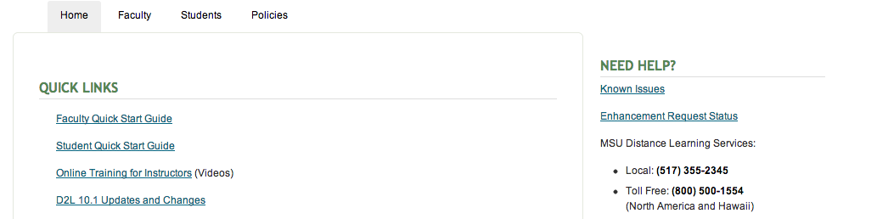
Course Management
http://help.d2l.msu.edu/

Slide 24
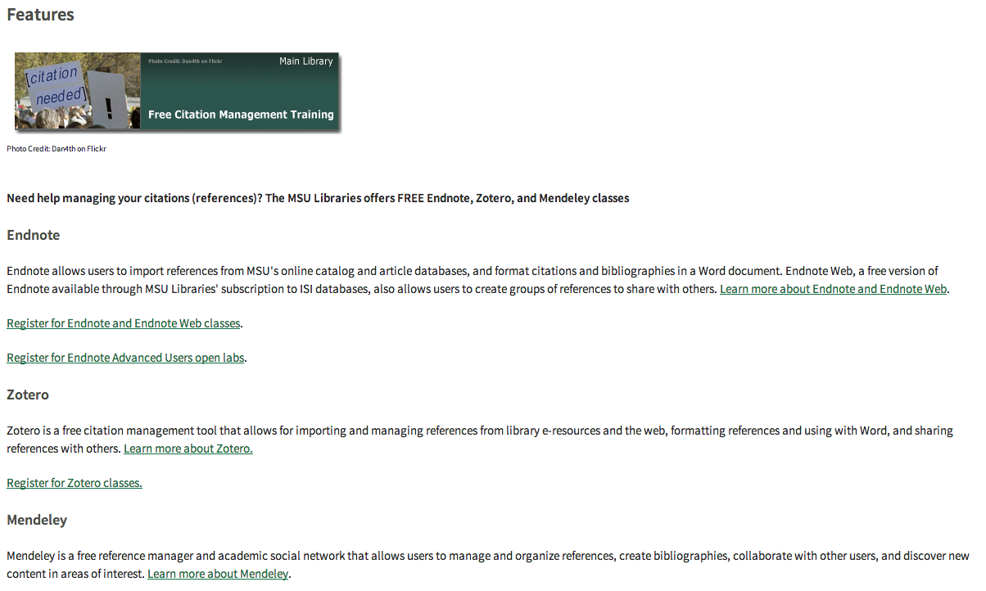
Bibliographic Management
http://classes.lib.msu.edu/

Slide 25
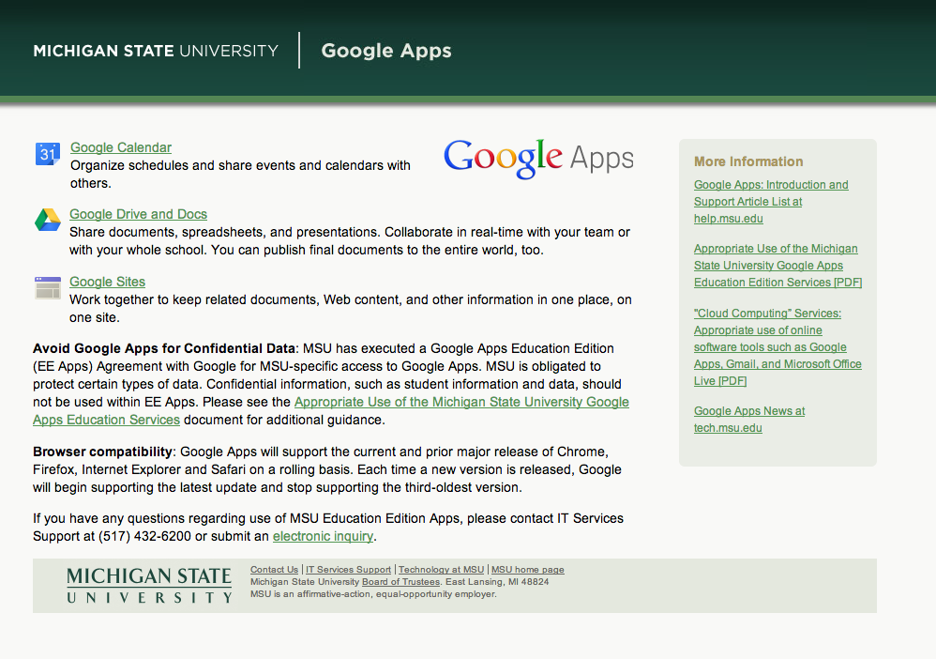
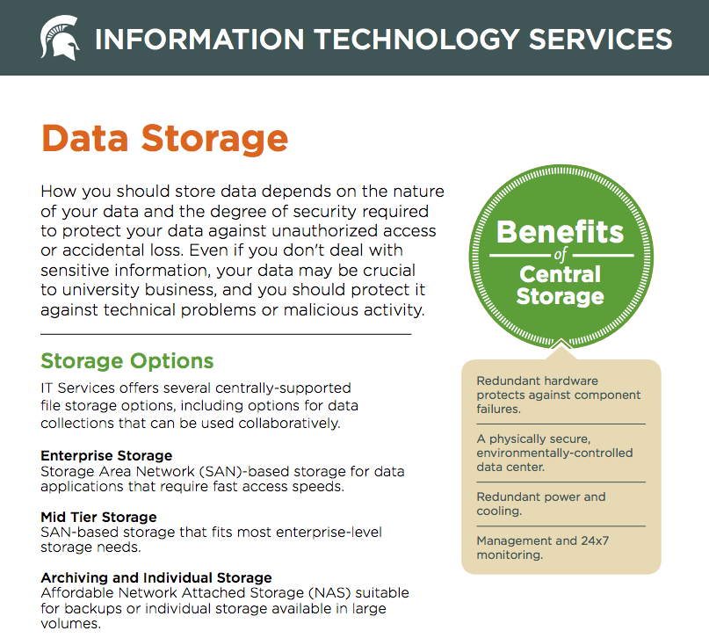
File Management
http://tech.msu.edu/storage/

Slide 26

RDM Systems
File Storage
File System
File Format
File Content
File Systems
Hierarchical
Database Systems
Hierarchical, Relational, or Object Oriented
Asset Management Systems
Combination of Database and File System
Notes:
Interpretation
Content
Carrier/computer file
Network/file system
Hard drive
walknboston

Slide 27
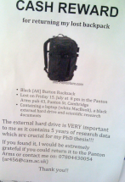


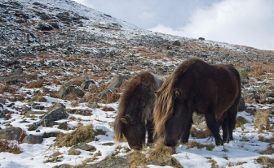
Storage Architecture
File Management
Documentation
Practices
Data Management
Access Management
Storage Options
Single points of failure
Backup Strategy
File Organization
File Naming
File Formats
Project Documentation
Process Documentation
Data Documentation
(cc) Will Scullin
Sharing Data
Publishing Data
Archiving Data
(cc) Alan Cleaver

Slide 28
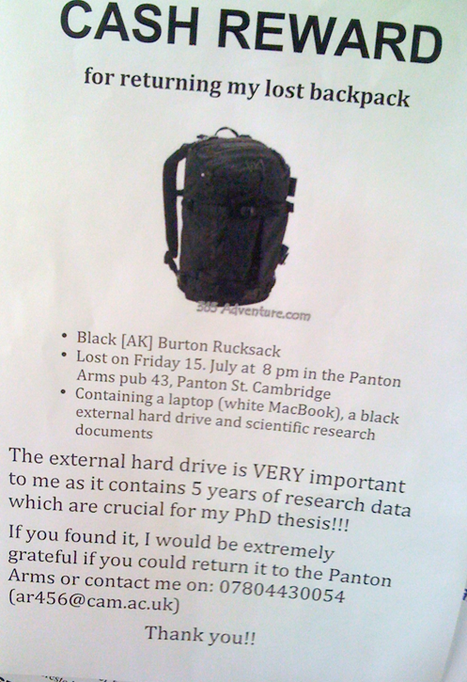
Storage Architecture
Storage Options
Single points of failure
Backup Strategy
File Storage
File System
File Format
File Content

Slide 29
Storage Architecture
Storage Options ←
Single points of failure
Backup Strategy
Optical Storage
CD-ROM
Solid-State Storage
USB Flash Drives
Magnetic Storage
Internal Hard Drives
External Hard Drives
Networked Storage
Server and Web Storage
Managed Networked Storage
“Cloud Storage”
DVD-ROM
Blu-ray Discs
Memory Cards
“Internal Device Storage”
Tape Drives
Tape Libraries

Slide 30
Storage Architecture
Storage Options
Single points of failure ←
Backup Strategy
Good practices for avoiding single points of error:
Use managed networked storage whenever possible
Move data off of portable media
Never rely on one copy of data
Do not rely on CD or DVD copies to be readable
Be wary of software lifespans (e.g. Angel)
Limited “Task” Term | Short “Project” Term | Long “Life” Term
Optical Media CD, DVD, Blu-ray Portable Flash Media USB Flash Drives Memory Cards Internal Memory | Magnetic Storage Internal HD External HD Networked Storage Server/Web Space Cloud Storage | Networked Storage Managed Network Magnetic Storage Tape Drives
Notes:
A single point of failure occurs when it would only take one event to destroy all data on a device (e.g. dropped hard drive)

Slide 31
Storage Architecture
Storage Options
Single points of failure
Backup Strategy ←
Good practices for creating a backup strategy:
Make 3 copies
E.g. original + external/local + external/remote
E.g. original + 2 formats on 2 drives in 2 locations
Geographically distribute and secure
Local vs. remote, depending on needed recovery time
Know what resources are available to you: personal computer, external hard drives, departmental, or university servers may be used

Slide 32

Storage Architecture
File Management
Documentation
Practices
Data Management
Access Management
Storage Options
Single points of failure
Backup Strategy
File Organization
File Naming
File Formats
Project Documentation
Process Documentation
Data Documentation
(cc) Will Scullin
Sharing Data
Publishing Data
Archiving Data
(cc) Alan Cleaver

Slide 33
File Management
File Organization
File Naming
File Formats
File Storage
File System
File Format
File Content
Notes:
Simple
File Plan
Advanced
Directory Manifest
GIT, Subversion
Content Management Systems (CMS)
Expert
Data management systems (DMS)

Slide 34
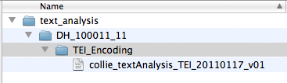
File Management
File Organization ←
File Naming
File Formats
Create a file plan
Better chance you will use a standard method when the time comes
Simple organization is intuitive to team members and colleagues
Reduces unsynchronized copies in personal drives and email attachments
Notes:
Choose a meaningful directory hierarchy
Primary subject, Secondary subject, Tertiary subject
Investigator, Process, Date
Instrument, Date, Sample

Slide 35
File Management
File Organization
File Naming ←
File Formats
Utilize a file naming convention
Create logical sequences for sorting through many files and versions
Identify what you’re searching for by filename by using a primary term
If not using a version control system, implement simple versioning
It’s sort of like a tweet
Should not exceed 255 characters for most modern operating systems
Example file names using simple version control: | Primary term:
lakeLansing_waltM_fieldNotes_20091012_v002.doc | location
OrgChart2009_petersK_20090101_d001.svg | content
20110117_sharpeW_krillMicrograph_backscatter3_v002.tif | date
borgesJ_collocation_20080414.xml | person
Notes:
Good Practices for file naming:
Meaningful & descriptive
Capital letters or underscores differentiate between words
Surname first followed by initials of first name
Decide on a simple “versioning” method (e.g. file_v001)
Use alphanumeric characters (e.g. abc123)
Meaningful but short (255 character limit)
Descriptive while still making sense
Capital letters or underscores differentiate between words
Surname first followed by initials of first name
More on handout
NameOfStudy_Location_Date_FG#_transcribedby_NameOfTranscriber_v###.DOCX

Slide 36
File Management
File Organization
File Naming
File Formats ←
Make an informed decision in selecting file formats
It is important to choose platform and vendor-independent file formats to ensure the best chance for future compatibility
“Open” formats are often (but not always) supported broadly by a community rather than individually by a company or vendor
Format Genre | Great | Not Bad | Avoid
TEXT | .txt; .odt; .xml; .html | .pdf; .rtf; .docx | .doc
AUDIO | .flac; .wav | .ogg; .mp3 | .wma; .ra; .ram; compression
VIDEO | .mp2/.mp4, MKV |  | .wmv; .mov; .avi; compression
IMAGE | .tif; .png; .svg; .jpg | .gif; | .psd; compression
DATA | .sql; .csv; .xml | .xlsx | .xls; proprietary DB formats
Notes:
Good choices for file formats:
Non-proprietary
Open, documented standard
Common usage by research community
Standard representation (ASCII, Unicode)
Unencrypted
Uncompressed

Slide 37
Storage Architecture
File Management
Documentation
Practices
Data Management
Access Management
Storage Options
Single points of failure
Backup Strategy
File Organization
File Naming
File Formats
Project Documentation
Process Documentation
Data Documentation
(cc) Will Scullin
Sharing Data
Publishing Data
Archiving Data
(cc) Alan Cleaver

Slide 38
Documentation
Practices
Project Documentation
Process Documentation
Data Documentation
File Storage
File System
File Format
File Content
Notes:
Simple
README.txt
Advanced
Wiki’s
Workflow diagrams
Expert
Project Management
Metadata Standards
Ontologies

Slide 39
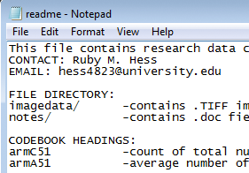
Documentation
Practices
Project Documentation ←
Process Documentation
Data Documentation
Good practice for documenting project information:
Oftentimes a team effort
At minimum, store documentation in readme.txt file
Include name of project, people, roles & contact information
Include executive summary or abstract for basic context
Include an inventory of servers, directories, data, lab equipment, and other resources
A great start for project documentation is a project charter
Notes:
Shouldn’t I have already documented basic project information in an abstract or introduction in a paper or thesis?
Yes, but this information is meant to be contextual information that can be used to better understand the data. It would accompany the data if shared.
Sometimes called a project charter
Wiki’s, GIT, or other version control systems can really turn this simple charter into an authoritative record of the research

Slide 40
Documentation
Practices
Project Documentation
Process Documentation ←
Data Documentation
Good practices for documenting processes:
Sometimes an individual effort, sometimes collaborative
Protocols, software or code settings, code commentary
Workflow descriptions (text) or diagrams (image)
Include example scripts, inputs, outputs if applicable
A great start for process documentation is a lab notebook
Example of R code commentary
# Cumulative normal density pnorm(c(-1.96,0,1.96))
Notes:
Why do I need to document the way I process and analyze data?
Researchers will need detailed information to reuse or verify your data.
Again, Methodology sections are not comprehensive

Slide 41
Documentation
Practices
Project Documentation
Process Documentation
Data Documentation ←
Good practices for documenting data:
Use standard methods of documentation where they exist
Metrics/Measurements
Code Book
Metadata Standard
unit
metadata
~1.57×107 K = Temperature of the sun (center)
measure/metric

Slide 42
Storage Architecture
File Management
Documentation Practices
Data Management
Access Management
Storage Options
Single points of failure
Backup Strategy
File Organization
File Naming
File Formats
Project Documentation
Process Documentation
Data Documentation
Sharing Data
Publishing Data
Archiving Data
(cc) Alan Cleaver

Slide 43
Access Management
Sharing Data
Publishing Data
Archiving Data
File Storage
File System
File Format
File Content
Notes:
Simple
Email
Website
Collaboration Tools
Advanced
Networked Storage
Expert
Data Repository

Slide 44
Access Management
Sharing Data ←
Publishing Data
Archiving Data
Good practices for sharing or distributing data:
Basics
Synchronization, Versioning, Access Restrictions (and logs)
Collaborative tools can save time and effort (and help with scale)
Intellectual property
Data itself not protected by copyright law in U.S.
Expressions of data (forms, reports, visuals) can be copyrightable
Data can be licensed similarly to software
Ethics
Human subjects (e.g. IRB restrictions)
Private/sensitive information

Slide 45
Access Management
Sharing Data
Publishing Data ←
Archiving Data
Good practices for publishing data:
Not Publishing
Self Publishing (Web Site)
Create and add data citations to personal websites
Journal (Supplementary Material)
Publish data with a journal that will provide a persistent link to your dataset (e.g. DOI, handle)
Archive/Repository
Institutional (see above example)
Disciplinary (e.g. article & data)
Notes:
Scoop, not IRB approved, etc

Slide 46
Access Management
Sharing Data
Publishing Data
Archiving Data ←
Good practices for archiving research data:
LOCKSS!
Archive documentation with data
Write costs for data management and archiving into your research budgets (and in some cases, proposals)
Define access policies including restrictions or embargos
Understand requirements for submission of data prior to project completion

Slide 47
Storage Architecture
File Management
Documentation Practices
Data Management
Access Management
Storage Options
Single points of failure
Backup Strategy
File Organization
File Naming
File Formats
Project Documentation
Process Documentation
Data Documentation
Sharing Data
Publishing Data
Archiving Data

Slide 48
Questions?
Store – Three Copies on Three Disks in Three Locations
Organize – If you make a plan, you just might follow it.
Document – What would my colleagues need to know to understand this data?
Share – Data makes an impact
Slides are HERE: http://tiny.cc/yvdpqw
Aaron Collie
Digital Curation Librarian
collie@msu.edu

